Slide 1
Lab 2 Stationarity and Cointegration Case study of biodiesel fuel and soybean oil
2022 Term 2: FRE 530

Slide 2
Roadmap
Stationarity Tests - Levels
Dickey Fuller test
Augmented Dickey Fuller test
Lags
Flow chart of testing specification
Stationarity Tests – First differences
Cointegration
Engle Granger 2 step test
Engle Granger function to retrieve correct critical values
Johansen Procedure
Notes:
In Week 1, Kurt emphasized that importance of stationarity when working with time series data. If we run a regression with non-stationary data then the estimated relationship may be spurious. Usually taking the first difference of the data will make it stationary, but doing so will make it hard to interpret the coefficients.
One exception to this rule is when two data series are cointegrated, which Kurt will talk more about later. In this lab, I will show you the codes to test for stationarity in R and how to interpret the results. You will see the same data and results in Kurt’s slides

Slide 3
Packages
Load the following packages
pacman::p_load(here, readxl, dplyr, janitor, Quandl, xts, lubridate, urca, forecast, tidyverse, vars)

Slide 4
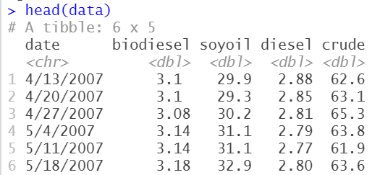
Data
Data sources
Biodiesel and soybean oil – Iowa Stata University
Diesel – U.S. EIA
Crude – U.S. EIA
Load data_lecture2.csv posted on Canvas

Slide 5
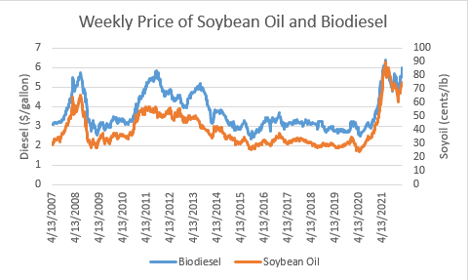
Data
Notes:
Soybean oil is a key biodiesel input. In this case price of soybean oil was multiplied by 0.07 (the long run relationship). The graph shows that both price series follow similar stochastic trend. The gap between these two lines represents the margin of the processor. In most cases, the margin stays relatively constant over time, provides hint that these two price series are cointegrated.

Slide 6
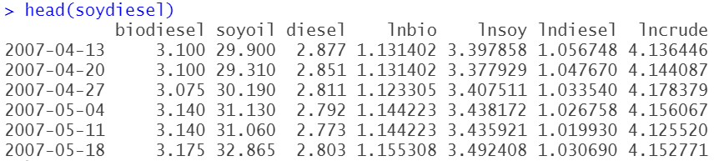
Data Cleaning
data <- data %>%
mutate(date = mdy(date),
lnbio = log(biodiesel),
lnsoy = log(soyoil),
lndiesel = log(diesel),
lncrude = log(crude))
soydiesel <- xts(data[,c("biodiesel", "soyoil", "diesel", "lnbio", "lnsoy", "lndiesel", "lncrude")], order.by = data$date)

Slide 7
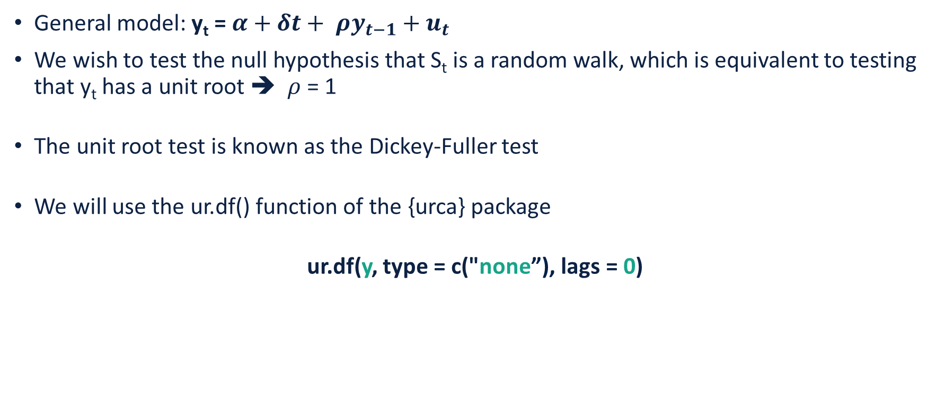
Dickey-Fuller Test
General model: y_{t} = $α+δt+ ρy_{t−1}+u_{t}$
We wish to test the null hypothesis that S_{t} is a random walk, which is equivalent to testing that y_{t} has a unit root ➔ $ρ$ = 1
The unit root test is known as the Dickey-Fuller test
We will use the ur.df() function of the {urca} package
ur.df(y, type = c("none”), lags = 0)

Slide 8
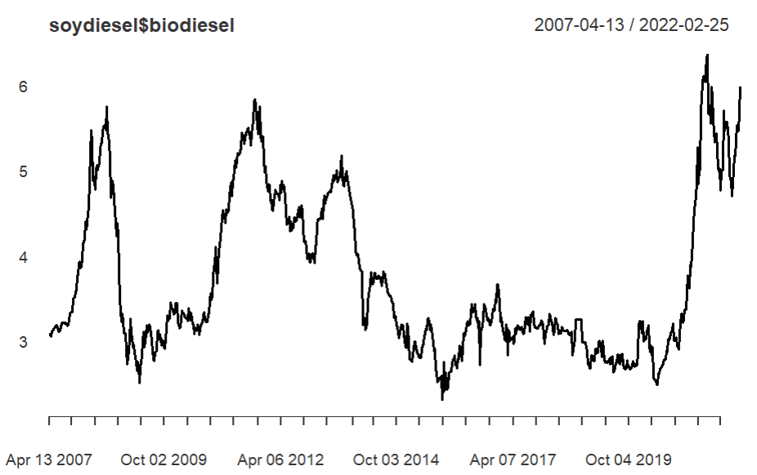
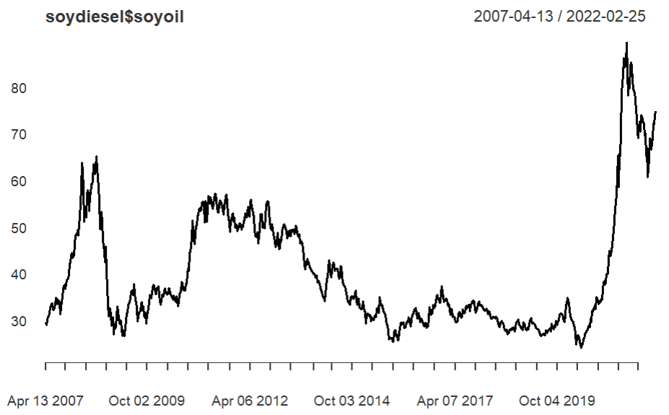
Dickey-Fuller Test

Slide 9
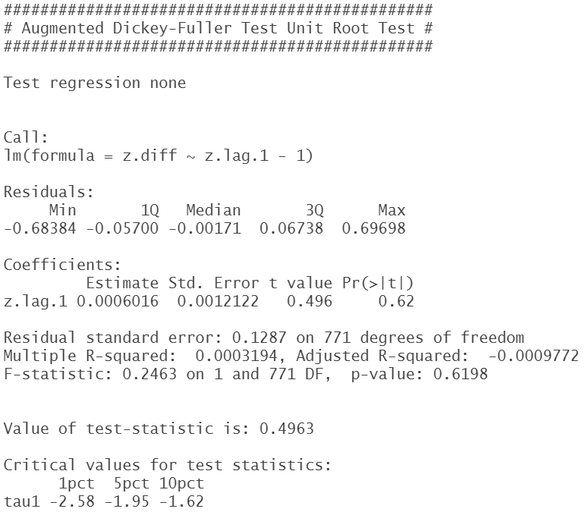
R – Dickey Fuller Test
df_biodiesel <- ur.df(soydiesel$biodiesel, type = c("none"), lags = 0)
summary(df_ biodiesel)
Interpretation
Absolute value of τ₁ t-statistic is smaller than the absolute value of the critical values
Fail to reject the null hypothesis of a unit root
Biodiesel price is not stationray

Slide 10

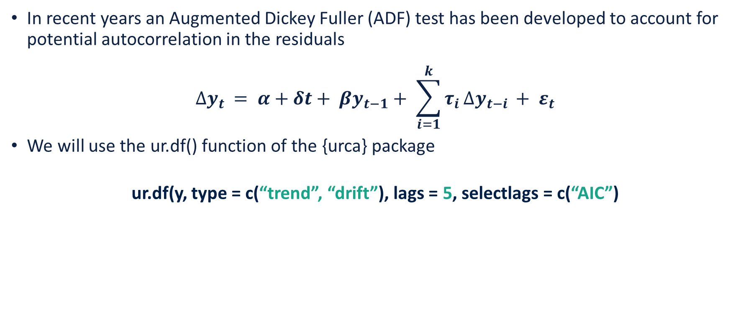
Augmented Dickey-Fuller (ADF) test
y_{t} = $α+δt+ ρy_{t−1}+u_{t}$
In recent years an Augmented Dickey Fuller (ADF) test has been developed to account for potential autocorrelation in the residuals
$$∆y_{t }= α+δt+ βy_{t−1}+ \sum_{i=1}^{k}{τ_{i}}∆y_{t−i }+ ε_{t}$$
We will use the ur.df() function of the {urca} package
ur.df(y, type = c(“trend”, “drift”), lags = 5, selectlags = c(“AIC”)

Slide 11
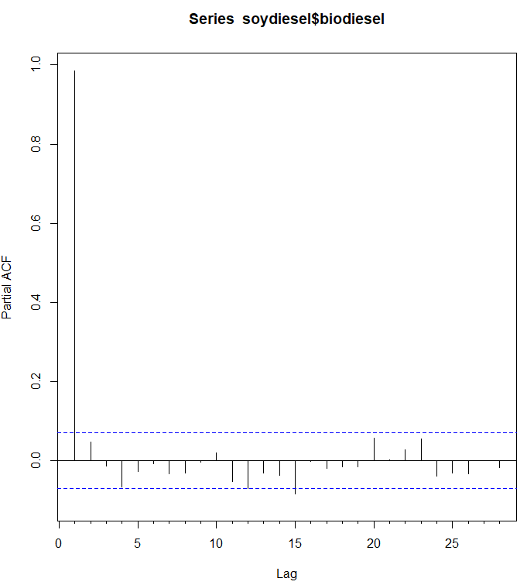
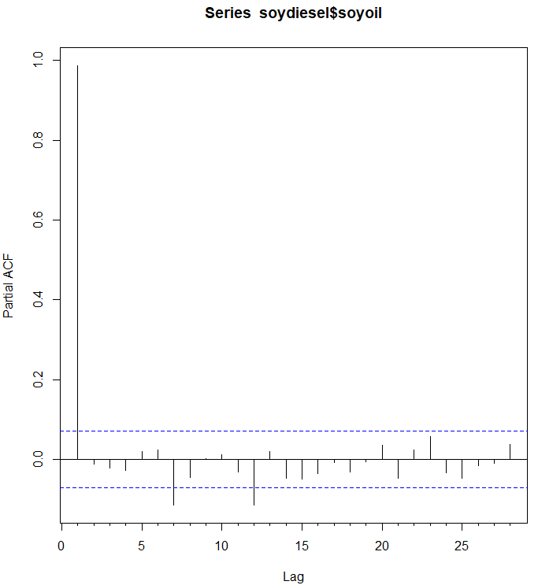
Lag length selection
Partial autocorrelation function – Pacf()

Slide 12
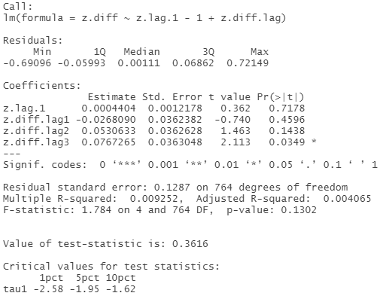
Lag length selection
{urca}’s automatic lag selection functionality
summary(ur.df(soydiesel$biodiesel, type = c("none"), lags = 4, selectlags = c("AIC")))

Slide 13
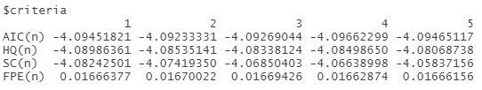

Lag length selection
VARselect() function of the {var} package
Select lag length with lowest AIC
VARselect(soydiesel$biodiesel, lag.max = 5)
VARselect(soydiesel$soyoil, lag.max = 5)

Slide 14
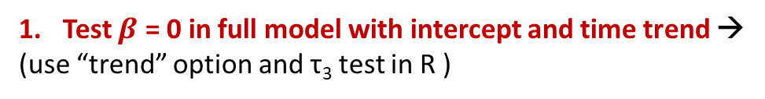
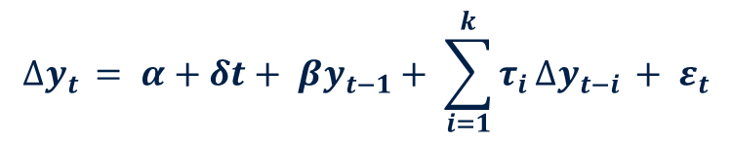

$$∆y_{t }= α+δt+ βy_{t−1}+ \sum_{i=1}^{k}{τ_{i}}∆y_{t−i }+ ε_{t}$$
Test $β$ = 0 in full model with intercept and time trend →
(use “trend” option and τ₃ test in R )
Reject
(no unit root)
No Reject
2. Test significance of time trend ($δ$ = 0) in full model.
Use “trend” option and Φ₃ test in R.
Reject
(no unit root)
No Reject
(remove and re-estimate)
Use the “drift” option to re-estimate without a trend.
3. Test $β$ = 0 in model with intercept and not trend.
Use the τ₂ test in R.
Reject
(no unit root)
No Reject
Use “drift” option and Φ₁ test in R.
4. Test significance of constant (α = 0)
Reject
(no unit root)
No Reject (remove and re-estimate)
Use the “no constant” option to re-estimate without an intercept.
5. Test $β$ = 0
Use τ₁ test in R.
Reject: no unit root
No Reject: unit root

Slide 15
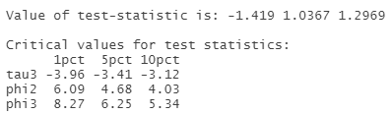
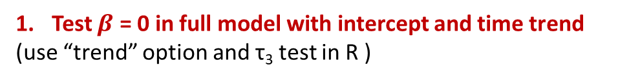

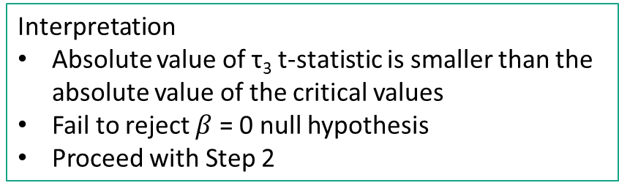
ADF test – Step 1
$$∆y_{t }= α+δt+ βy_{t−1}+ \sum_{i=1}^{k}{τ_{i}}∆y_{t−i }+ ε_{t}$$
Test $β$ = 0 in full model with intercept and time trend
(use “trend” option and τ₃ test in R )
Reject
(no unit root)
No Reject
2. Test significance of time trend ($δ$ = 0) in full model.
summary(ur.df(soydiesel$biodiesel, type = c("trend"), lags = 4))
Interpretation
Absolute value of τ₃ t-statistic is smaller than the absolute value of the critical values
Fail to reject $β$ = 0 null hypothesis
Proceed with Step 2

Slide 16
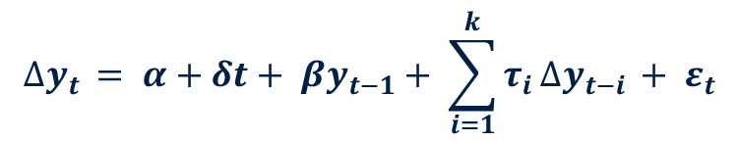
ADF test – Step 2
$$∆y_{t }= α+δt+ βy_{t−1}+ \sum_{i=1}^{k}{τ_{i}}∆y_{t−i }+ ε_{t}$$
2. Test significance of time trend ($δ$ = 0) in full model.
Use “trend” option and Φ₃ test in R.
Reject
(no unit root)
No Reject
(remove and re-estimate)
Use the “drift” option to re-estimate without a trend.
3. Test $β$ = 0 in model with intercept and not trend.
summary(ur.df(soydiesel$biodiesel, type = c("trend"), lags = 4))
Interpretation
Absolute value of the Φ₃ t-statistic is smaller than the critical values
Fail to reject the null hypothesis that time trend is not significant
Proceed with Step 3

Slide 17

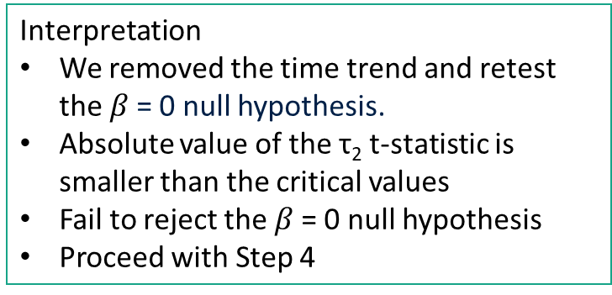
ADF test – Step 3
$$∆y_{t }= α+δt+ βy_{t−1}+ \sum_{i=1}^{k}{τ_{i}}∆y_{t−i }+ ε_{t}$$
Use the “drift” option to re-estimate without a trend.
3. Test $β$ = 0 in model with intercept and not trend.
Use the τ₂ test in R.
Reject
(no unit root)
No Reject
4. Test significance of constant (α = 0)
summary(ur.df(soydiesel$biodiesel, type = c(“drift"), lags = 4))
Interpretation
We removed the time trend and retest the $β$= 0 null hypothesis.
Absolute value of the τ₂ t-statistic is smaller than the critical values
Fail to reject the $β$= 0 null hypothesis
Proceed with Step 4

Slide 18

ADF test – Step 4
$$∆y_{t }= α+δt+ βy_{t−1}+ \sum_{i=1}^{k}{τ_{i}}∆y_{t−i }+ ε_{t}$$
Use “drift” option and Φ₁ test in R.
4. Test significance of constant (α = 0)
Reject
(no unit root)
No Reject (remove and re-estimate)
Use the “no constant” option to re-estimate without an intercept.
5. Test $β$= 0
Use τ₁ test in R.
Reject: no unit root
No Reject: unit root
summary(ur.df(soydiesel$biodiesel, type = c(“drift"), lags = 4))
Interpretation
Absolute value of the Φ₂ t-statistic is smaller than the critical values
Fail to reject the null hypothesis that the intercept term is not significant
Proceed with Step 5

Slide 19


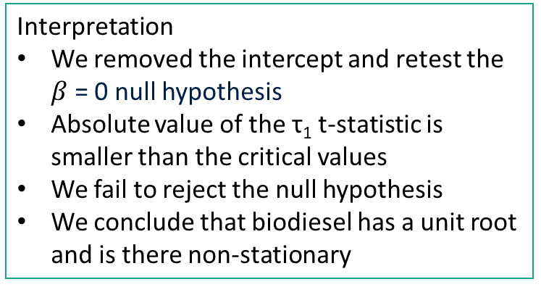
ADF test – Step 5
$$∆y_{t }= α+δt+ βy_{t−1}+ \sum_{i=1}^{k}{τ_{i}}∆y_{t−i }+ ε_{t}$$
Use the “no constant” option to re-estimate without an intercept.
5. Test $β$ = 0
Use τ₁ test in R.
Reject: no unit root
No Reject: unit root
summary(ur.df(soydiesel$biodiesel, type = c("none"), lags = 4))
Interpretation
We removed the intercept and retest the $β$ = 0 null hypothesis
Absolute value of the τ₁ t-statistic is smaller than the critical values
We fail to reject the null hypothesis
We conclude that biodiesel has a unit root and is there non-stationary

Slide 20
ADF test – output in lecture notes
Pbiodiesel_{t}
Test Type | Test Statistic | 1% Critical | 5% Critical | 10% Critical
No Constant | 0.337 | -2.580 | -1.950 | -1.620
Drift | -1.524 | -3.430 | -2.860 | -2.570
Trend | -1.419 | -3.960 | -3.410 | -3.120
Fail to reject unit root with all testing types and all three levels of significance.
PSoyoil_{t}
Test Type | Test Statistic | 1% Critical | 5% Critical | 10% Critical
No Constant | 0.722 | -2.580 | -1.950 | -1.620
Drift | -0.815 | -3.430 | -2.860 | --2.570
Trend | -0.783 | -3.960 | -3.410 | -3.120
Fail to reject unit root with all testing types and all three levels of significance.

Slide 21
Roadmap
Stationarity Tests - Levels
Dickey Fuller test
Augmented Dickey Fuller test
Lags
Flow chart of testing specification
Stationarity Tests – First differences
Cointegration
Engle Granger 2 step test
Engle Granger function to retrieve correct critical values
Johansen Procedure

Slide 22
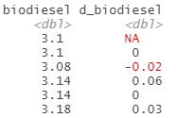
First difference
To take the difference, we use diff.xts()

Slide 23
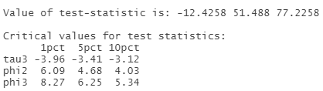
ADF test – Step 1 (biodiesel)
VARselect(diff.xts(soydiesel$biodiesel, na.pad = F), lag.max = 5)
summary(ur.df(diff.xts(soydiesel$biodiesel, na.pad = F), type = c("trend"), lags = 3))
Interpretation
Absolute value of τ₃ t-statistic is bigger than the absolute value of the critical values
Reject the unit root null hypothesis
Differenced price series is I(0) stationary
Not necessary to proceed with next steps
If you do, you will still arrive at the same conclusion

Slide 24
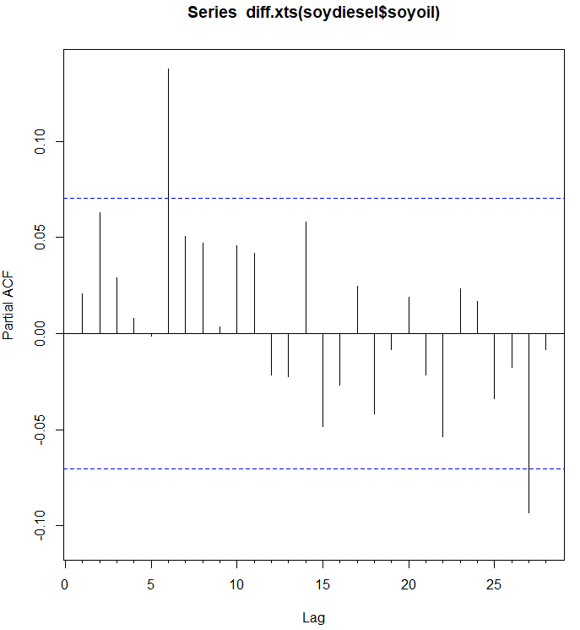
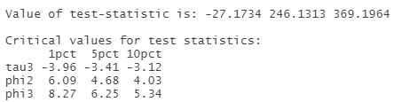
ADF test – Step 1 (soybean oil)
R’s VARselect() function does not allow for lags = 0. Output suggests lags = 2
Stata’s varsoc function does, and the output suggests lags = 0
Partial autocorrelation function suggests lags = 0
Interpretation
Differenced price series is I(0) stationary

Slide 25
Roadmap
Stationarity Tests - Levels
Dickey Fuller test
Augmented Dickey Fuller test
Lags
Flow chart of testing specification
Stationarity Tests – First differences
Cointegration
Engle Granger 2 step test
Engle Granger function to retrieve correct critical values
Johansen Procedure

Slide 26
Engle Granger Method
We meet the necessary condition that prices in levels are I(1) and prices in first differences are I(0)
Step 1 – estimate the longrun relationship between biodiesel and soybean oil
Collect the residuals
Step 2 – run an ADF test on the residuals

Slide 27
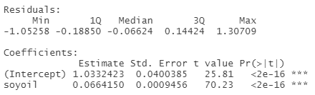
Engle Granger Method
Step 1 – estimate the longrun relationship between biodiesel and soybean oil
PBioDiesel_{t} = α + βPSoyoil_{t} + ε_{t}
reg_biodieselsoy <- lm(biodiesel ~ soyoil, data = soydiesel)
summary(reg_biodieselsoy)

Slide 28
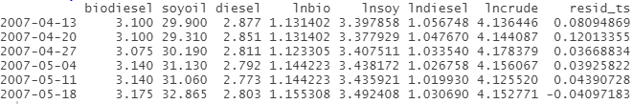
Engle Granger Method
Collect the residuals from the previous regression
In R, (1) save the residuals, (2) convert residuals to ts object, (3) merge to soydiesel
resid_soydiesel <- resid(reg_biodieselsoy)
resid_ts <- xts(resid_soydiesel, order.by = index(soydiesel))
soydieselr <- merge.xts(soydiesel, resid_ts)

Slide 29

Engle Granger Method
Step 2 – run an ADF test for a unit root on the residuals
No need to use time trend or intercept because, by construction, the residuals will have a zero mean
If we reject the null hypothesis of a unit root, then we conclude that the two price series are cointegrated
VARselect(soydieselr$resid_ts)
summary(ur.df(soydieselr$resid_ts, type = c("none"), lags = 3))
Interpretation
It appears that we can reject the unit root null hypothesis
But this is not correct because we must use different critical values

Slide 30
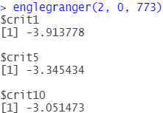
Engle Granger Method
Stata gives the correct critical values as part of the egranger test, but R does not
We wrote an R function that will give you the correct critical values
englegranger(var, trend, n)
var = # of variables, in our case 2 (biodiesel and soybean oil)
trend = 0 if no trend in step 1 regression, 1 if we included a trend in step 1 regression
n = number of observations

Slide 31
Engle Granger Method
We must compare the t-statistic of -3.0262 with the critical values of -3.91 (1%), -3.34 (5%), -3.05 (10%). The absolute value of the test statistic is smaller than the absolute values of the critical values, so we fail to reject the null hypothesis of a unit root.
We find no evidence that biodiesel fuel and soybean oil prices are cointegrated

Slide 32
Retest for cointegration using log prices
We will now work with log of prices – address skewed nature of price data
Step 1
reg_lnbiodieselsoy <- lm(lnbio ~ lnsoy, data = soydiesel)
summary(reg_lnbiodieselsoy)
resid_lnsoydiesel <- resid(reg_lnbiodieselsoy)
lnresid_ts <- xts(resid_lnsoydiesel, order.by = index(soydiesel))
soydieselr <- merge.xts(soydiesel, lnresid_ts)

Slide 33
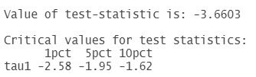
Retest for cointegration using log prices
Step 2
VARselect(soydieselr$lnresid_ts)
summary(ur.df(soydieselr$lnresid_ts, type = c("none"), lags = 3))
englegranger(2, 0, 773)
We can reject the null hypothesis of a unit root at the 95% confidence level. We have evidence that the pair of prices are cointegrated.

Slide 34
Roadmap
Stationarity Tests - Levels
Dickey Fuller test
Augmented Dickey Fuller test
Lags
Flow chart of testing specification
Stationarity Tests – First differences
Cointegration
Engle Granger 2 step test
Engle Granger function to retrieve correct critical values
Johansen Procedure

Slide 35
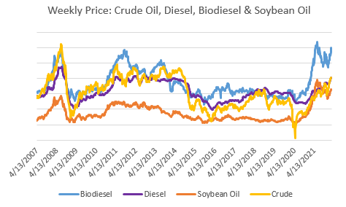
Testing for cointegration with multiple prices
Let’s say we want to test for the cointegration of crude oil, diesel, biodiesel, and soybean oil
We use the Johansen Procedure to test the cointegration of more than two data series.

Slide 36
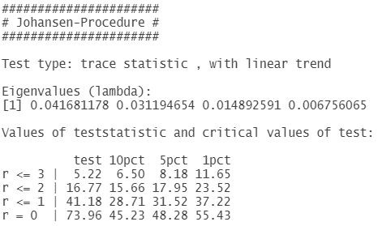
Testing for cointegration with multiple prices
jotest <- soydiesel[,c("lncrude", "lndiesel", "lnbio", "lnsoy")]
VARselect(jotest, lag.max = 10)
summary(ca.jo(jotest, type = c("trace"), ecdet = c("none"), K = 3, spec = c("transitory")))
Interpretation
We work from the bottom row to to top, and stop only when it is no longer possible to reject the null
r = 0 -> reject null of rank 0
r <=1 -> reject null of rank <=1
r <= 2 -> reject null at 90% confidence

Slide 37
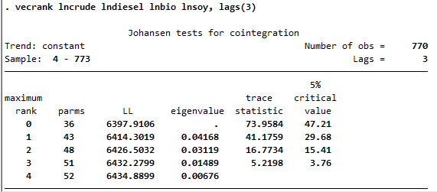
Testing for cointegration with multiple prices
Note that there is a difference in critical values across programs (read here and here for more info); trace statistic is the same though.
But the important thing is that we reject the null that there is no cointegrating relationship.

Slide 38
Summary
Stationarity Tests – DF and ADF tests in R
VARselect(y, lag.max = n)
ur.df(y, type = c(“none”, “trend”, “drift”), lags = n)
ur.df(diff.xts(y, na.pad = F), type = c(“none”, “trend”, “drift”), lags = n)
Cointegration
Step 1 – estimate the long run relationship between prices
Collect the residuals
Step 2 – conduct an ADF test on residuals and use correct critical values
Johansen Procedure
Tests for cointegration of more than 2 data series

